Slide 1

FINAL YEAR RESEARCH PROJECT
End Term Presentation
Automated Detection of Hardcoded Secrets in Modern Source Code Repositories using LLM-Augmented Static Analysis
Supervised By: Dr. Bhanu Pratap Rajak
Group No.: 03
Name of the Student(s) with Regd. No.:
Satyajeet Satapathy - 2241019340
Dinanath Dash - 2241004161
Avignyan Sarangi - 2241019304
Ashutosh Raj - 2241018015
Department of Computer Sc. and Engineering
Faculty of Engineering & Technology (ITER)
Siksha ‘O’ Anusandhan (Deemed to be) University
Bhubaneswar, Odisha
‹#›
Notes:
Good morning. I'm Dinanath, representing Group 3 alongside Satyajeet, Avignyan, and Ashutosh. Today, we are presenting our End Term Research Project on the automated detection of hardcoded secrets in modern source code repositories. Specifically, we are going to demonstrate how we utilized LLM-augmented static analysis to solve this.

Slide 2
Presentation Outline
Problem Statement & Motivations
Problem Statement
Motivations
Literature Review
Existing Solutions & Limitations
Proposed Methodology & Approach
Key Components/Modules & Algorithms Used
Dataset & Tools/Technologies
Experimentation
System Specification
Experimental Results
Performance Analysis
Conclusion and Future Scope
References
‹#›
Notes:
Our presentation will move rapidly from the problem of alert fatigue to our proposed hybrid architecture, followed by our current implementation results and the bottlenecks we are addressing.

Slide 3
Problem Statement
Domain: DevSecOps and Software Supply Chain Security.
Problem Statement:
Traditional static secret scanners lack semantic understanding, generating prohibitively high False Positive Rates by flagging safe test variables.
To resolve this, we engineered a two-stage hybrid scanning pipeline that uses Regex as a Stage-1 pre-filter and invokes a locally deployed, 4-bit quantized Meta Llama 3 model.
By analyzing a strict 11-line context window, our solution drastically reduces false alarms while maintaining total offline execution and data privacy.
‹#›
Notes:
Our research operates within the domain of DevSecOps and Software Supply Chain Security. The fundamental problem we are addressing is that traditional static secret scanners lack semantic understanding. Because they rely heavily on pattern matching, they generate prohibitively high False Positive Rates by constantly flagging safe test variables.
To resolve this, we engineered a two-stage hybrid scanning pipeline. We use standard Regex as a Stage-1 pre-filter, which then invokes a locally deployed, 4-bit quantized Meta Llama 3 model. By feeding the LLM a strict 11-line context window, our solution drastically reduces false alarms. Most importantly, it does this while maintaining total offline execution and data privacy.

Slide 4
Motivations
Motivation:
High False Positive Rates causes severe "Alert Fatigue" among security teams, delaying CI/CD pipelines and increasing the likelihood that genuine, critical vulnerabilities are overlooked in large-scale codebases.
Primary Objective:
Designed and implemented a two-stage hybrid scanning pipeline that drastically reduces False Positive Rates in secret detection without compromising recall capabilities.
Measurable Objectives:
Evaluated baseline Regex performance against the Hybrid LLM pipeline using a quantitative Confusion Matrix.
Guaranteed zero-trust data privacy by executing a fine-tuned LLM entirely offline, while benchmarking the resulting inference latency trade-offs.
‹#›
Notes:
Why is this necessary? Because high False Positive Rates cause severe 'Alert Fatigue' among security teams. When developers are flooded with false alarms, CI/CD pipelines are delayed, and the likelihood of ignoring genuine, critical vulnerabilities in large-scale codebases increases drastically.
Our primary objective was to design and implement a pipeline that drastically reduces these False Positive Rates without compromising our recall capabilities. We measured this success by evaluating baseline Regex performance against our Hybrid LLM pipeline using a quantitative Confusion Matrix. Furthermore, we guaranteed zero-trust data privacy by executing the fine-tuned LLM entirely offline, while strictly benchmarking the inference latency trade-offs that come with local execution.
I will now hand it over to Ashutosh to discuss the current literature and where existing solutions fall short.

Slide 5
Literature Review
Table1: Summary of Existing Approaches and Research Limitations
Author | Methods/ Techniques Used | Dataset Used | Research Outcomes | Findings & Limitations
Schwarz (2025) | "Countermind" multi-layered security architecture using Semantic Boundary Logic (SBL) and Parameter-Space Restriction (PSR). | N/A (Conceptual/Architectural design). | Shifts LLM defenses from reactive post-hoc filtering to proactive pre-inference structural validation. | Post-hoc filters are brittle against prompt injections; models inherently struggle to distinguish trusted instructions from untrusted data.
Li et al. (2025) | Injecting vulnerability steering vectors into LLM activation layers without altering original parameters. | SARD, FFmpeg+Qemu, Reveal, REEF. | Outperformed state-of-the-art methods with a 12.86% F1-score increase on real-world datasets. | Existing representation methods focus on overall semantics instead of isolating specific vulnerability concepts.
Kim et al. (2025) | Reinforcement learning (RL) based context generator to infer contextual signals from user prompts. | SafetyInstruct, Advbench, Wildjailbreak, XSTest. | Reduces harmful responses while preventing unnecessary refusals of benign requests. | Conventional LLM frameworks fail on ambiguous tasks; extracting context is necessary to prevent bypassing safeguards.
Jin (2025) | Categorization of LLM adaptation into base application, static augmentation, RAG, fine-tuning, and hybrid fusion. | N/A (Survey paper analyzing standardized benchmarks). | Identified optimal architectural strengths (encoder vs. decoder) for different security priorities. | High token consumption, context window limits, and poor generalization remain major barriers.
‹#›
Notes:
Following Dinanath’s problem statement, we must examine why current solutions fail in production environments. Slides 5 and 6 summarize our comprehensive review of recent literature.
The data reveals three recurring points of failure across the industry. First, as noted by Jin in 2025, attempting to adapt LLMs for static analysis results in severe token consumption and context window exhaustion. Second, vulnerability models fundamentally lack line-level granularity, as shown by Apostolidis, and focus too heavily on overall file semantics rather than isolated vulnerability concepts, as highlighted by Li. Finally, standard LLM metrics are dangerously inflated on open-source data due to training contamination, meaning they fail when applied to proprietary corporate codebases.

Slide 6
Literature Review contd.
Table2: Summary of Existing Approaches and Research Limitations, contd.
Author | Methods/ Techniques Used | Dataset Used | Research Outcomes | Findings & Limitations
Dozono et al. (2025) | Empirical evaluation of 5 frontier LLMs comparing open-source vs. closed-source code performance. | CWE-Bench-Java (Open) and TS-Vuls (Closed, commercial Teamscale codebase). | Precision dropped significantly from 56% on open-source code to 34% on closed-source code. | LLM metrics are heavily inflated on open-source data due to training contamination.
Apostolidis et al. (2025) | CppCheck static analysis filtered by a fine-tuned CodeBERT vulnerability prediction model. | Big-Vul and ReVeal (C/C++ GitHub samples). | Reduced false positives, improving static analysis practicality with minimal impact on detection accuracy. | Vulnerability prediction models lack line-level granularity; static tools suffer from overwhelming false alarms.
Guo et al. (2023) | Systematic review of 130 false positive mitigation studies across 5 technical categories. | N/A (Literature Review). | Established a taxonomy for false positive mitigation and identified deep learning and NLP as future directions. | Current approaches suffer from low explainability, ambiguous concept definitions, and dataset biases.
Muske & Khedker (2015) | Data flow analysis computing Complete-range Non-deterministic Value (cnv) variables. | Embedded C system applications (SCMS, BCM). | Cut redundant model checking calls by 49.49% and reduced false positive elimination time by 39.28%. | Speed gains were achieved at the cost of missing 2.78% of false positives due to execution path over-approximation.
‹#›
Notes:
Following Dinanath’s problem statement, we must examine why current solutions fail in production environments. Slides 5 and 6 summarize our comprehensive review of recent literature.
The data reveals three recurring points of failure across the industry. First, as noted by Jin in 2025, attempting to adapt LLMs for static analysis results in severe token consumption and context window exhaustion. Second, vulnerability models fundamentally lack line-level granularity, as shown by Apostolidis, and focus too heavily on overall file semantics rather than isolated vulnerability concepts, as highlighted by Li. Finally, standard LLM metrics are dangerously inflated on open-source data due to training contamination, meaning they fail when applied to proprietary corporate codebases.

Slide 7
Research Gap & Improvements
Identified Limitation 1: Token Inefficiency & Latency Bottlenecks
Recent surveys (e.g., Jin, 2025) highlight that analyzing entire repositories using LLMs results in severe token consumption and context window exhaustion.
Our Engineered Solution: We utilized a "cascading filter" approach. By using deterministic Regex as a Stage-1 pre-filter, we only invoked the LLM on a strict 11-line context window, bypassing the latency constraints of pure-LLM scanners.
Identified Limitation 2: Granularity and "Context Blindness"
Existing vulnerability models often evaluate overall file semantics rather than isolating specific vulnerability concepts (Li et al., 2025), and lack line-level granularity (Apostolidis et al., 2025).
‹#›
Notes:
We translated these failures into specific research gaps. Limitation 1 is Token Inefficiency. Throwing an entire repository at an LLM is computationally unviable. Our engineered solution is a 'cascading filter' approach. We use deterministic Regex purely as a Stage-1 pre-filter. This ensures we only invoke the LLM on a strict 11-line context window, completely bypassing the latency constraints of pure-LLM scanners.
Limitation 2 is Context Blindness. Existing models evaluate the whole file and miss the nuances of specific lines.

Slide 8
Research Gap & Improvements contd.
Our Engineered Solution: We extracted the Abstract Syntax Tree (AST) context (5 lines above and below the Regex match). Our LoRA fine-tuning specifically trained the model to evaluate variable scope and dummy test parameters within this micro-context.
Identified Limitation 3: The Data Privacy Paradigm
State-of-the-art LLM security tools rely on cloud-based APIs. Sending proprietary, unredacted corporate source code to external servers (OpenAI/Anthropic) violates Zero-Trust security models and data compliance laws.
Our Engineered Solution: Total offline execution. We bridged this gap by deploying a 4-bit quantized Meta Llama 3 8B model locally using the Apple MLX framework, leveraging Unified Memory for secure, on-device inference.
‹#›
Notes:
To solve this Context Blindness, we extracted the Abstract Syntax Tree context—specifically, 5 lines above and below the initial Regex match. We then applied LoRA fine-tuning to explicitly train our model to evaluate variable scope and dummy test parameters within that exact micro-context.
The final, and arguably most critical, gap is Limitation 3: The Data Privacy Paradigm. State-of-the-art security tools currently rely on cloud-based APIs. Sending proprietary, unredacted corporate source code to external servers like OpenAI or Anthropic is a direct violation of Zero-Trust security models and data compliance laws.
Our engineered solution mandates total offline execution. We bridged this gap by deploying a 4-bit quantized Meta Llama 3 8B model locally. By leveraging the Apple MLX framework and Unified Memory, we achieve secure, on-device inference without data ever leaving the machine.
I will now hand it over to Avignyan, who will walk you through the architectural implementation of these solutions.

Slide 9
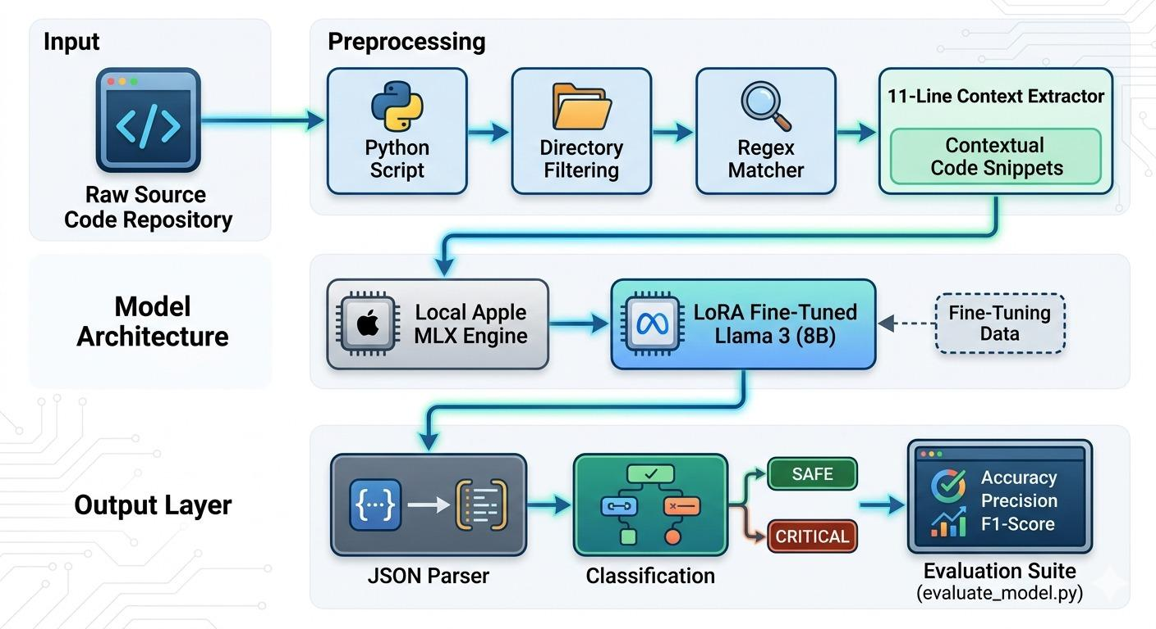
Proposed Solution & Architecture
Fig. 1: Schematic Model Diagram of the Proposed Model
‹#›
Notes:
Building on the privacy and latency requirements Ashutosh outlined, this is the schematic of our engineered pipeline.
The flow begins by feeding a raw source code repository into our Python preprocessing script. We apply strict directory filtering to drop binaries and irrelevant files, then run the deterministic Regex Matcher. When Regex flags a potential secret, our 11-Line Context Extractor isolates the match along with its immediate surrounding Abstract Syntax Tree.
This micro-context is then passed to our Local Apple MLX Engine. Here, our LoRA fine-tuned Meta Llama 3 8B model evaluates the semantics. The output layer forces a strict JSON response, which our parser evaluates to classify the secret as either 'SAFE' or 'CRITICAL', before passing the metrics to our evaluation suite.

Slide 10
Dataset & Tools/Technologies
Dataset Description:
Source: The open-source CredData benchmark dataset.
Composition: The benchmark comprises 27,000 lines of source code. Due to extreme local compute constraints, legacy baseline tools were evaluated against the full dataset, while the Hybrid LLM was rigorously benchmarked against a standardized 1,000-hit subset.
Tools & Technologies:
Language & Orchestration: Python 3.10+
AI Model: Meta Llama 3 8B Instruct (4-bit quantized).
Compute Framework: Apple MLX Framework.
Hardware: Local execution on Apple Silicon (M-series Mac) utilizing Unified Memory for offline inference.
‹#›
Notes:
To test this architecture, we utilized the open-source CredData benchmark, which comprises approximately 27,000 lines of source code.
It is important to note a critical engineering constraint here: due to extreme local compute limitations, we evaluated the legacy baseline tools against the full 27,000-line dataset, but rigorously benchmarked our Hybrid LLM against a standardized 1,000-hit subset.
Our stack is strictly Python 3.10+ orchestrating a 4-bit quantized Meta Llama 3 8B Instruct model. We rely entirely on the Apple MLX Framework running locally on M-series Apple Silicon. By utilizing Apple's Unified Memory, we achieve total offline inference.

Slide 11
Experimentation: System Specifications & Parameters
Hardware & Compute Environment: All inference executed locally on Apple Silicon (M-series Mac) utilizing Unified Memory to strictly enforce zero-trust data privacy constraints.
Pipeline Implementation:
Phase 1 (Regex + 11-line AST context extraction) and Phase 2 (Apple MLX inference) were fully integrated and operationalized.
Model fine-tuning (4-bit quantized, LoRA at 3000 iterations) successfully stabilized strict JSON output parsing.
‹#›
Notes:
Executing entirely on local hardware ensures we strictly enforce our zero-trust data privacy constraints. Corporate code never touches a network interface.
Regarding the pipeline implementation, both Phase 1—the Regex and AST context extraction—and Phase 2—the Apple MLX inference—are fully integrated and operationalized. A major hurdle in LLM integration is standardizing output. We solved this through targeted model fine-tuning. Running LoRA at 3000 iterations successfully stabilized the model to output strict, predictable JSON parsing, allowing seamless integration with our evaluation suite.
I will now hand it over to Satyajeet to break down the exact performance metrics and address our current latency challenges.

Slide 12
Experimentation: Experimental Results
Experimental Setup: Conducted a head-to-head comparative analysis on the CredData dataset against industry-standard offline scanners (TruffleHog and Gitleaks).
The Baseline Failure (Context Blindness):
TruffleHog failed entirely (Precision: 0.4301, Recall: 0.0123).
Gitleaks (Regex) maintained high Precision (0.8600) but suffered catastrophic False Negatives, missing 74% of actual secrets (Recall: 0.2600).
Hybrid Model Performance:
Overall Accuracy: Achieved 87.0%, demonstrating stable and reliable classification across a standardized 1,000-hit evaluation subset.
Achieved a dominant F1-Score of 0.8723 within the test sample.
Precision remained highly competitive at 0.8117, while Recall surged to 0.9427.
‹#›
Notes:
Avignyan walked you through the architecture, but architecture is theoretical until benchmarked. We conducted a head-to-head comparative analysis on the CredData dataset against two industry standards: TruffleHog and Gitleaks.
The baseline failure is entirely rooted in context blindness. TruffleHog failed our offline execution parameters entirely, yielding a near-zero recall of 0.0123. Gitleaks, functioning purely on Regex, maintained a high precision of 0.8600, but suffered catastrophic false negatives. Because it lacks semantic awareness, Gitleaks missed 74% of actual hardcoded secrets, resulting in a recall of just 0.2600.
Against this, our Hybrid Model achieved an overall accuracy of 87.0% across our standardized 1,000-hit subset. While maintaining highly competitive precision at 0.8117, our recall surged to 0.9427.

Slide 13
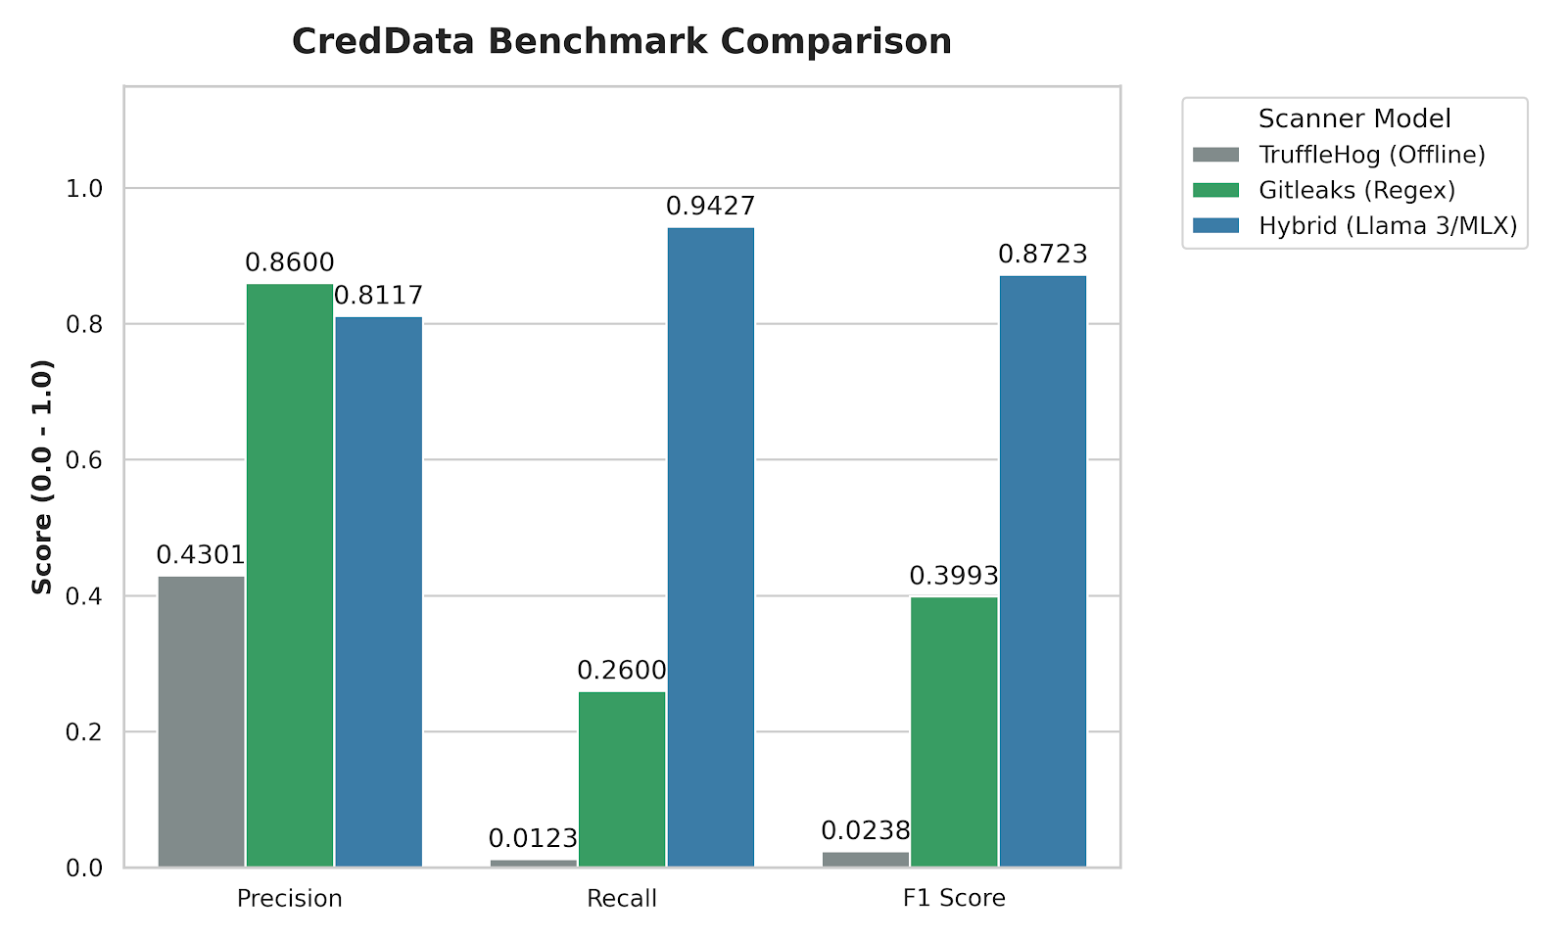
Experimentation: Experimental Results contd.
Fig. 2: Precision, Recall, and F1-Score evaluation of the Hybrid Llama 3/MLX architecture against industry baselines.
‹#›
Notes:
Looking at the visual breakdown, the trade-off is clear. We sacrificed a negligible fraction of precision compared to Gitleaks to achieve a massive leap in recall. Consequently, our hybrid model dominates the F1-Score metric at 0.8723, comprehensively outperforming both baselines. We successfully eliminated the false alarms without blinding the scanner.

Slide 14
Experimentation: Performance Analysis
The Latency Reality: While the Apple MLX framework ensured Zero-Trust privacy via local execution, executing a quantized 8B parameter model was fundamentally slower than pure C-based Regex.
Pipeline Blocking: Executing sequential LLM inference on hundreds of initial Regex matches created a severe bottleneck, rendering it impractical for monolithic repository scans in a fast-paced CI/CD environment.
Prompt Engineering Impact: Implementation of a strict Few-Shot Prompting template halved the initial context processing time and stabilized outputs, but the baseline per-snippet inference speed remained a critical hurdle for production deployment.
‹#›
Notes:
However, we must address the engineering reality: latency. While the Apple MLX framework guarantees zero-trust privacy via local execution, running a quantized 8-billion parameter model is fundamentally slower than pure C-based Regex.
Currently, executing sequential LLM inference on hundreds of Regex matches creates a severe pipeline block. It is impractical for monolithic repository scans in a fast-paced CI/CD environment. We actively mitigated this by implementing a strict few-shot prompting template, which successfully halved our initial context processing time and stabilized the JSON output. But baseline per-snippet inference speed remains our primary technical hurdle for production deployment.

Slide 15
Conclusion and Future Scope
Conclusion: The hybrid LLM-augmented pipeline successfully eliminated Regex context-blindness (achieving an 87.23% F1-Score) and guaranteed zero-trust data privacy via local MLX execution, definitively validating the core research hypothesis.
Future Scope:
Cross-Dataset Validation: The model’s current performance is heavily biased toward the CredData benchmark. We plan to validate generalization by testing against the FPSecretBench dataset, pending access approval from the authors.
Aggressive Latency Mitigation: Shift research focus from detection accuracy to operational speed. Investigate batch processing through the MLX engine or aggressive model pruning to drop per-snippet inference times to a viable DevSecOps threshold.
Pipeline Integration: Package the validated Python/MLX architecture into a deployable CLI tool or a standardized GitHub Action for seamless CI/CD pipeline integration.
‹#›
Notes:
To conclude, our hybrid LLM-augmented pipeline definitively validated our core research hypothesis: we successfully eliminated Regex context-blindness—achieving an 87.23% F1-Score—while guaranteeing zero-trust data privacy via local MLX execution.
Moving forward, our immediate scope dictates three actions. First, cross-dataset validation. Our model is heavily biased toward the CredData benchmark, so we are pending access to the FPSecretBench dataset to test generalization. Second, aggressive latency mitigation. We are shifting focus from detection accuracy to operational speed, specifically investigating batch processing through the MLX engine. Finally, we plan to package this architecture into a standardized GitHub Action for seamless CI/CD integration.

Slide 16
References
Schwarz, D. (2025) 'Countermind: A Multi-Layered Security Architecture for Large Language Models', arXiv preprint arXiv:2510.11837v1.
Li, J. et al. (2025) 'Steering Large Language Models for Vulnerability Detection', 2025 IEEE International Conference on Acoustics, Speech and Signal Processing (ICASSP).
Kim, M., Caccia, L., Shi, Z., Pereira, M., Côté, M.-A., Yuan, X., and Sordoni, A. (2025) 'Learning to Extract Context for Context-Aware LLM Inference', Microsoft Research.
Jin, S. (2025) 'Large Language Models for Vulnerability Detection in Static Code Analysis: A Survey', 2025 8th International Conference on Artificial Intelligence and Big Data (ICAIBD).
Dozono, K., Engesser, J., Hummelt, B., Roehm, T., and Pretschner, A. (2025) 'Should We Evaluate LLM Based Security Analysis Approaches on Open Source Systems?', 2025 40th IEEE/ACM International Conference on Automated Software Engineering (ASE).
Apostolidis, G. D., Kalouptsoglou, I., Siavvas, M., Kehagias, D., and Tzovaras, D. (2025) 'AI-Enhanced Static Analysis: Reducing False Alarms Using Large Language Models', 2025 IEEE International Conference on Smart Computing (SMARTCOMP).
Guo, Z. et al. (2023) 'Mitigating False Positive Static Analysis Warnings: Progress, Challenges, and Opportunities', IEEE Transactions on Software Engineering, Vol. 49, No. 12, pp. 5154-5186.
Muske, T. and Khedker, U. P. (2015) 'Efficient Elimination of False Positives using Static Analysis', 2015 IEEE.
Notes:
These are the references that ground our methodology. Thank you everyone, we are now open to your questions.

Slide 17

‹#›
Notes:
These are the references that ground our methodology. Thank you everyone, we are now open to your questions.

